Slide 1
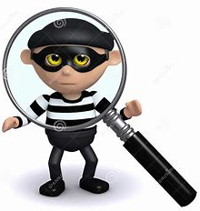
Plagiarism and Cheating
Just Don’t Do It!!

Slide 2
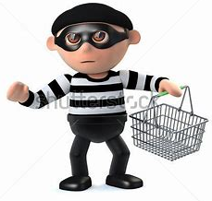

Would you steal something from a store?
NO!!!
We all know that’s wrong!!!
Then why would you steal someone else’s ideas online!?!?

Slide 3

Learning Goals and Success Criteria
We will develop an understanding of various forms of academic dishonesty and the consequences.
We will:
Define cheating and plagiarism in an academic setting
Explore the Four Factors of Fair Use
Identify ways to avoid plagiarism
See formatting for appropriate Works Cited

Slide 4

Plagiarism = Stealing Ideas from Others
When we look for information on the internet, through Google or through other databases we have access to, it’s important to remember that someone had to do a lot of work to get that information to you in your home.
It’s important that we show that we understand what we are learning!
It’s important to put things into our own words to show we understand!
It’s important to give credit to the person who worked so hard to bring you the answers you are looking for!
It’s important to tell your reader where you got your information, too!

Slide 5
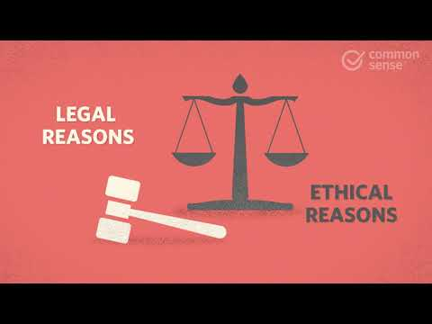
The Four Factors of Fair Use
… the purpose of the new
work is educational or the original work is transformed into something very different.
It's more likely to be fair use if ...
Purpose
Common examples:
Schoolwork and education
Criticizing or commenting
News reporting
Comedy
… the amount used is only a small portion of the original work or does not include the "heart" of the work.
… the nature of the original work is nonfiction or based on fact (rather than creative or fictional).
Amount
Nature
Effect
… the effect of the new
work does not include any negative impact on the
creator or the value of the original work (think $!).

Slide 6
ASK & ATTRIBUTE
Ask | Attribute
What kind of copyright license does the creative work have? How much of the work can you use? Do I need to get permission from the creator to use it? HOW? Do a reverse-image search to try to find the original creator of the image. If the photo has a regular copyright, email or get ahold of the creator to ask permission. | Have I provided attribution (give credit) to the creator? If you get permission, provide attribution by listing the author and date. Also add a link back to the photo's source. You might also use a citation.
Notes:
Sometimes there are sites which are free to use - look for the photos there …

Slide 7

Consequences … If you steal from a store?
Consequences … If you steal from a website?
Prices go up for everyone
Restorative Justice - saying “sorry” to your victim for what you’ve done Community Service - spending your time helping others
Jail - in the very worst cases
Redoing the assignment - you have to do the work 2X!!
The Principal and your Parents are notified (especially if you do this more than once and in more than one subject!)

Slide 8
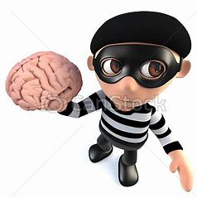
And what about Cheating?
That’s theft too!
I’m stealing other people’s work, their thinking and understanding! Doing my own work is how I will learn best where I need to improve!!

Slide 9


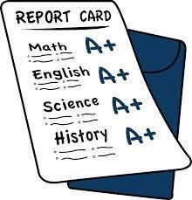

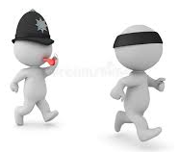
Cheating
People don’t start studying in time and panic.
People don’t care about the assignment and therefore don’t put in the effort, but want to hand in something!
Why do people cheat?
People are scared of failing. Sometimes they feel a lot of pressure.
People want to get a good mark, but don’t believe they can achieve at the level they want to.
People who cheat believe they will not get caught.

Slide 10

And, yes, teachers ask you to work together (collaborate) … What’s the difference between collaborating and cheating?
Collaboration:
Sharing and contributing ideas and answers
Building on the ideas of others
Everyone adds to the discussion/finished product
Learning and understanding for EVERYONE!!
Cheating:
Taking others ideas and saying they are yours
Failing to contribute: who wants to work with you if you do nothing?
Presenting someone else’s work as your own
NOT learning and understanding!!

Slide 11
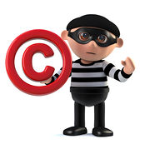
So how do you give credit to people’s ideas?
Create a Works Cited at the end of your work (presentation, report, etc,):
(books) Shakespeare, William. Macbeth. Oxford University Press, 2009. 3-127.
(pictures) Image: https://www.dreamstime.com/illustration/3d-burglar.html
(websites) “Corruption of Power in Macbeth.” St. Rosemary Institution, 2019. https://schoolworkhelper.net/corruption-in-macbeth/
You can use: EasyBib , BibMe,
OR · In Google Docs > Tools > Citations > Add Citation Source

Slide 12
And here’s what a Works Cited,
Properly Formatted using MLA, might look like:
Works Cited
Burglar Thief with Question Mark (slide 10)
https://www.dreamstime.com/illustration/3d-burglar.html
“Corruption of Power in Macbeth.” St. Rosemary Institution, 2019.
https://schoolworkhelper.net/corruption-in-macbeth/ May 25, 2022
Creativity, Copyright and Fair Use
https://docs.google.com/presentation/d/13Ouo6HCHWy_UuPc6NwHjmqOyrVU8J5ikWRZ2RNHO_wM/edit#slide=id.g12f37962108_0_20
Purdue Writing Lab. “Plagiarism Faqs // Purdue Writing Lab.” Purdue Writing Lab,
https://owl.purdue.edu/owl/avoiding_plagiarism/plagiarism_faq.html.
Shakespeare, William. Macbeth. Oxford University Press, 2009. 3-127.
What do you notice about the formatting?

